Slide 1
Hypothetical Retail Business Analysis
(Midterm Project)
Presented by: Salah Zaman on 09/09/24

Slide 2
Objective (purposes)
Understanding the importance and applications of data analytics in a retail business context.
By utilizing various tools like Excel, SQL, Python and Tableau for data-related tasks.
By going through the entire data analytics pipeline from collecting + cleaning the data files (customer, product, sales) to making business decisions.

Slide 3
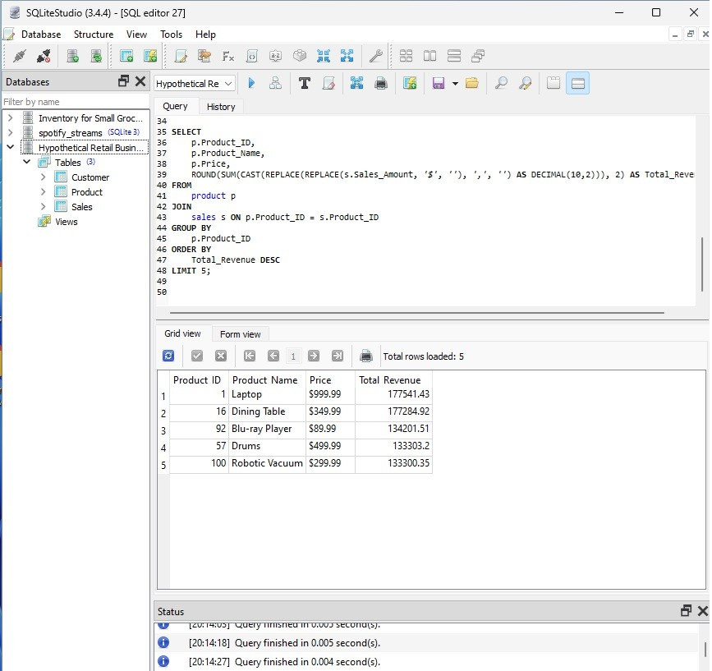
SQLite Queries

Slide 4
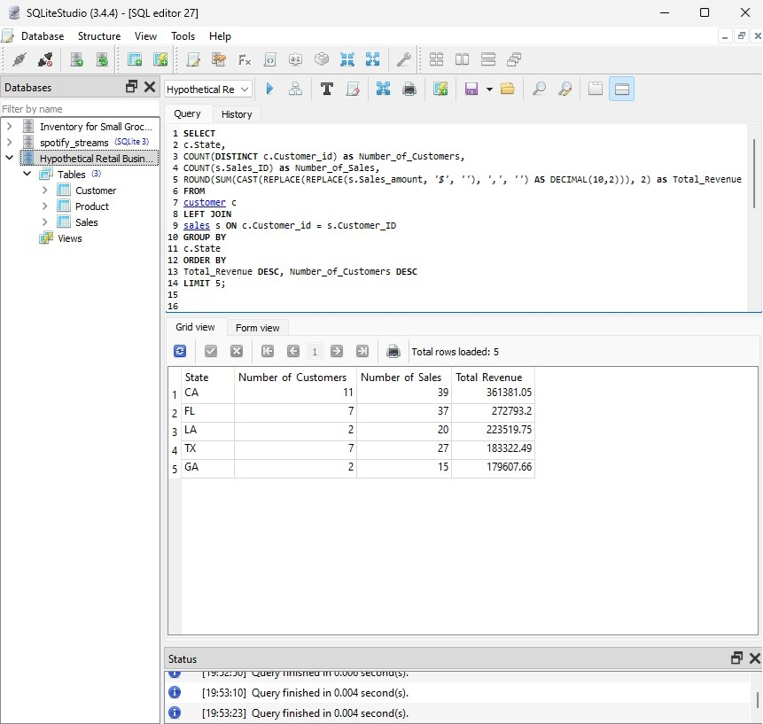
SQLite Queries (cont.)

Slide 5
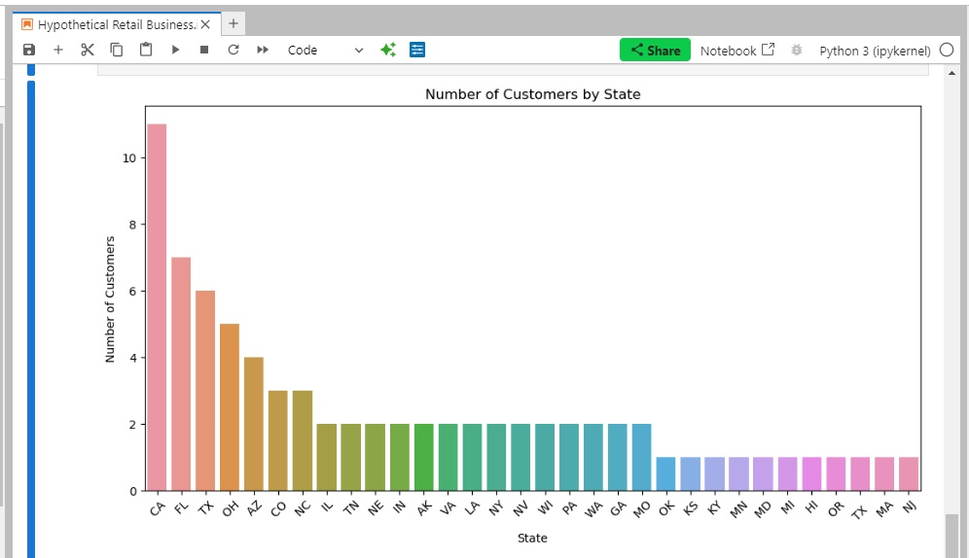
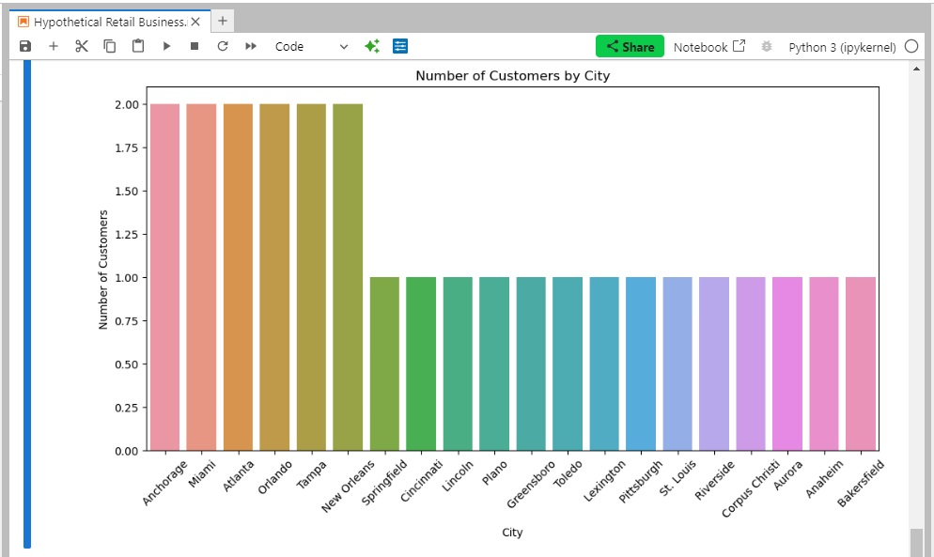
Python Data Analysis

Slide 6
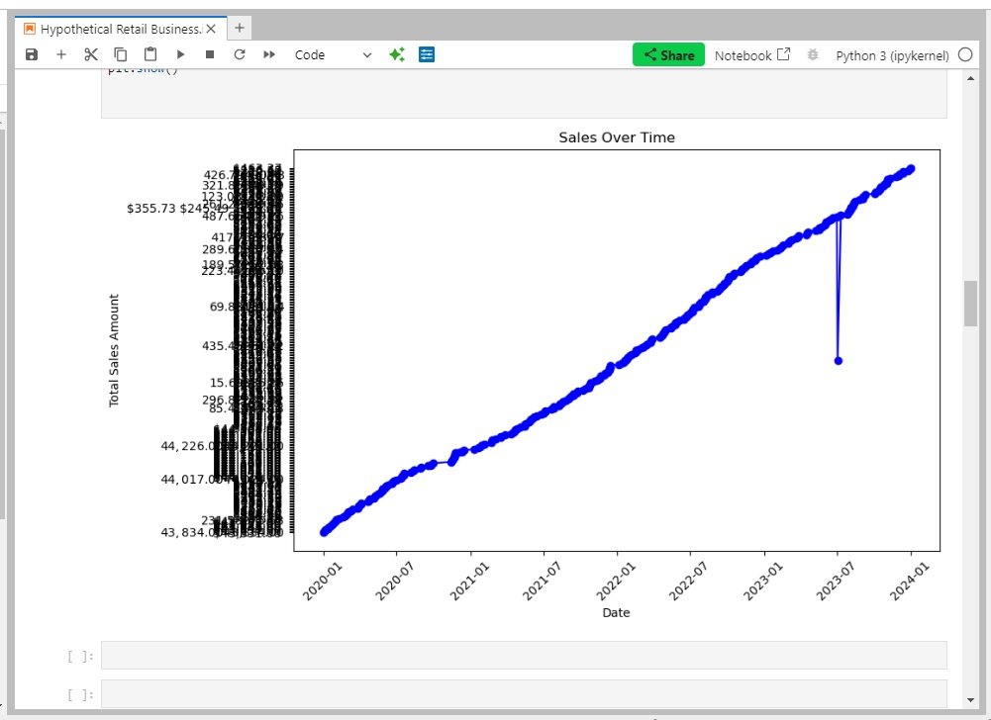
Python Data Analysis (cont.)

Slide 7
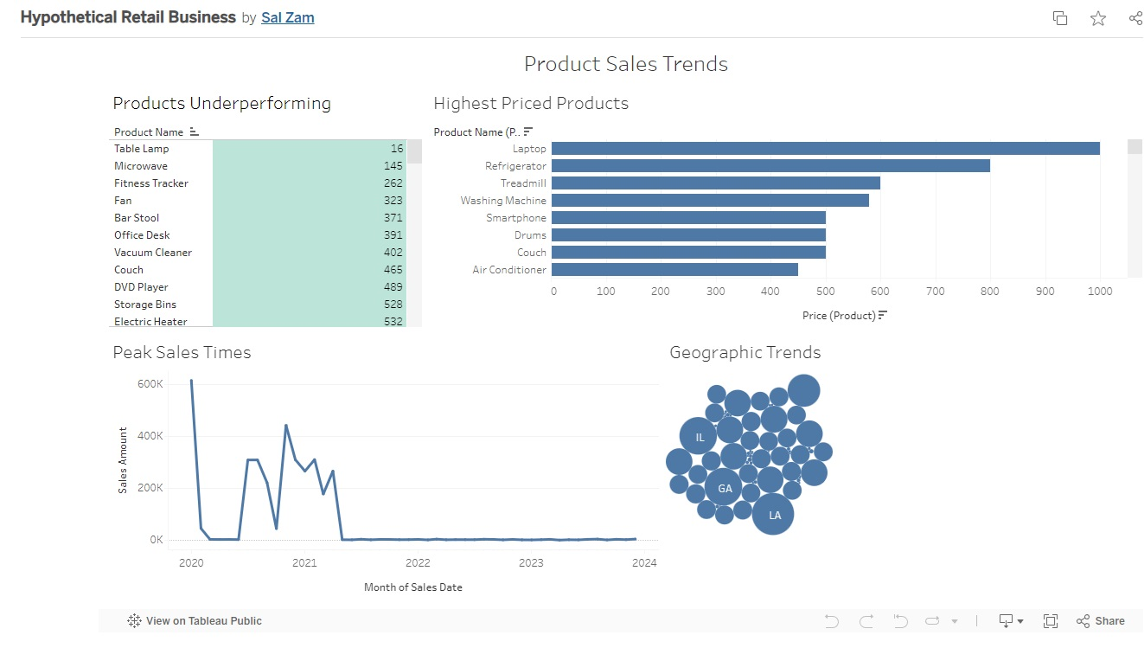
Dashboard Visualization

Slide 8
Questions?

